Slide 1
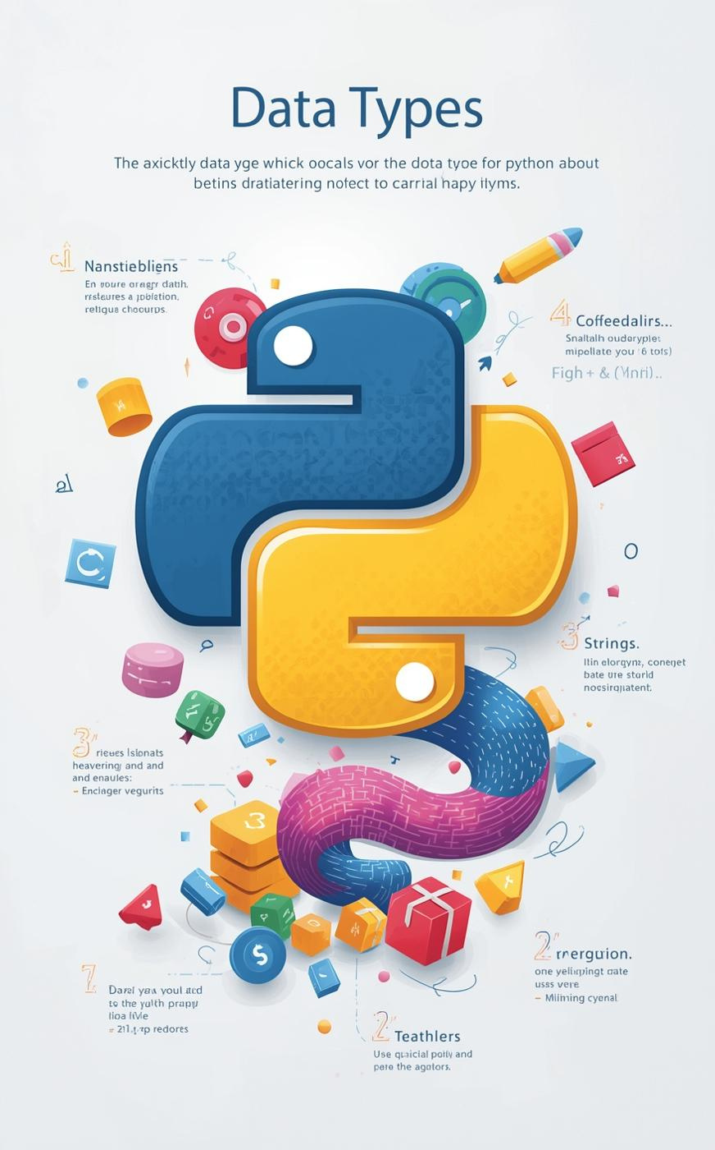

Exploring Data Types
Presented by:
Somesh Narayan Mishra
Rishabh Yadav
Som Mishra
Shaurya Raj
Srijan Singh

Slide 2

Introduction
Python data types are the foundation of how we manage and manipulate information within our programs. Understanding these types is essential for writing clean, efficient code. Here are some key points to consider:
  Data types dictate how variables are stored and manipulated.
  Each type has its specific use cases and advantages.
  Familiarity with data types leads to better programming practices.
As we journey through Python, we'll explore various data types, including numeric, sequence, boolean, set, and dictionary types, enriching our understanding of this versatile programming language.

Slide 3
Numeric Data Types
Python supports three main numeric types:
  int: Represents whole numbers, e.g., a = 5
  float: Represents decimal numbers, e.g., b = 5.0
  complex: Represents numbers with real and imaginary parts, e.g., c = 2 + 4j
These numeric types serve as essential weapons in your math arsenal, allowing for various mathematical operations and calculations. Understanding how to utilize these types effectively leads to cleaner, more efficient code, enhancing your programming experience in Python.

Slide 4
Sequence Data Types
In Python, data organization is key, and this is where sequence data types come into play.
  Strings: Immutable sequences of characters. Example: s = "Hello Python"
  Lists: Mutable collections that can hold various data types. Example: l = [1, 2, "Python", 3.14]
  Tuples: Immutable collections similar to lists but fixed in size. Example: t = (10, 20, 30)
Understanding these types is essential for effective programming, as they allow for organized data handling and manipulation in your Python programs.

Slide 5
The Boolean data type is fundamental in Python, allowing you to work with binary conditions. It consists of only two possible values:
  True
  False
These values are essential for making decisions in your code. Boolean expressions are often used in conditional statements, enabling logic that drives program flow.
For example:
x = True
y = False
print(type(x)) # <class 'bool'>
print(type(y)) # <class 'bool'>
Understanding how to leverage Boolean values is crucial for effective programming in Python.
Boolean Type

Slide 6
Sets in Python are unordered collections of unique elements, ensuring no duplicates are present. They are mutable, allowing for the addition and removal of items. The frozenset is an immutable version of a set, preserving the uniqueness but preventing modifications.
Key features of sets include:
  Fast membership testing
  Use cases in mathematical operations
  Syntax: s = set(["apple", "banana", "apple"]) results in {'banana', 'apple'}
Understanding sets is crucial for efficient data handling and manipulation in Python.
Set Data Types

Slide 7
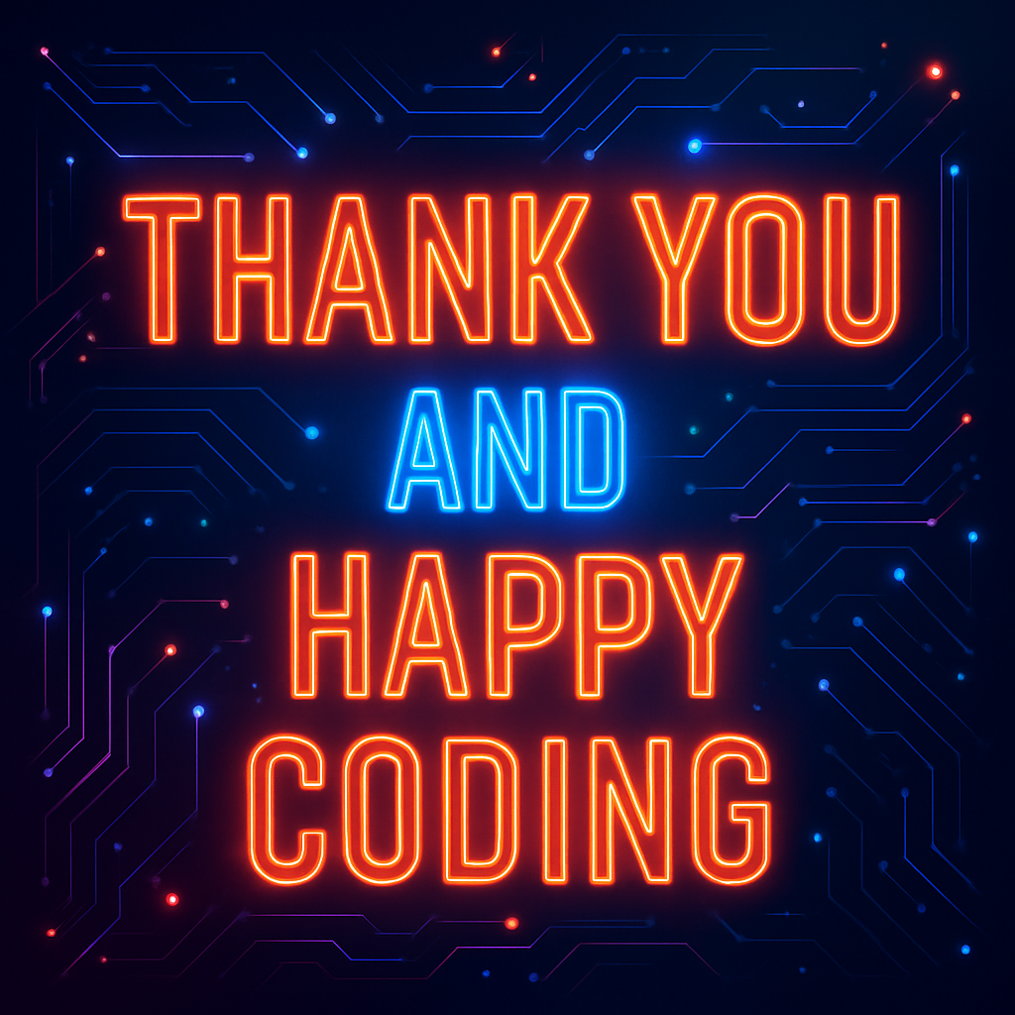
Python data types tie everything together by giving structure to the way information is stored and handled, making your code clearer and smoother.

